Slide 1
Functions, Lists, and File I/O in Sikuli/Jython
AUTHOR: NICK BELLI DATE: 04/27/2018

Slide 2
Functions
Defined using the “def” keyword
Can be declared anywhere in the program
  Best Practice is to define them at the top of your module for consistent execution success
Functions can take arguments, or be standalone
Work differently than C and Java functions
  Jython functions are executable statements, not declarations
**Caution: When testing in Sikuli, function calls can cache, giving false positives for testing. To test new functions or placements, close Sikuli and re-open to clear the cache. **

Slide 3
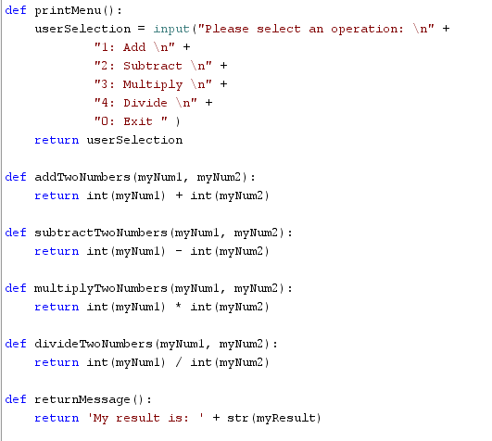
Function Example
Remember: Functions should follow KISS Methodology

Slide 4
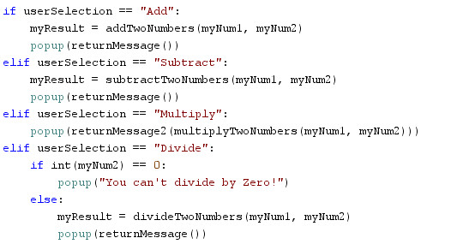
Calling functions
Remember the parentheses
Pass a matching number of arguments
Functions can be nested

Slide 5
Lists in Jython

Slide 6
Concepts in Lists
STORAGE
SYNTAX
Lists are dynamically sized
Lists can store different data types in the same list
Lists can be called by location in the list
    *Note* Lists have zero-based locations
Instantiating an empty List
    my_List = []
Instantiating a List with different types
    my_List = [1, “Bob”, 3]
Calling the object at position 1 in the list
    my_List[1]
      (Returns “Bob” from the above list)

Slide 7
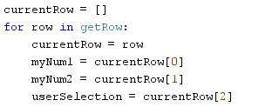

Lists Sikuli Example

Slide 8
File I/O
AKA: HOW TO USE FILES FOR FUN AND PROFIT!

Slide 9
Choosing the best file type for your application
Know your file type and how it is stored
    csv format is a simple and clean format for object storage, where each cell in Excel is delimited by a comma. This file type can also be opened in Notepad to check for empty cells (extra commas)
    csv format can use the built-in library _csv
Using your file in Jython
    Each comma delimited value can become an object in a list using the _csv.reader() function
    You can split each column value into its own variable for action, consideration, and testing
JUST REMEMBER:
    Make sure to close your file after you are done with it so that it doesn’t stay locked forever.
      Best Practice: Use “with open(filename) as csvfile” to auto-close after completion or failure of a script

Slide 10
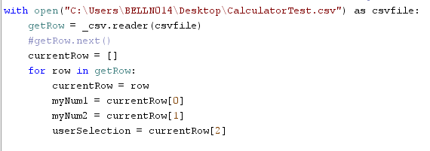
Opening and parsing a csv file
Example Script Snippet

Slide 11
Further Resources
http://www.jython.org/jythonbook/en/1.0/LangSyntax.html#functions
http://www.jython.org/jythonbook/en/1.0/DataTypes.html#lists-dictionaries-sets-and-tuples
http://www.jython.org/jythonbook/en/1.0/InputOutput.html#file-i-o
https://docs.python.org/2/library/csv.html#module-contents

